Slide 1
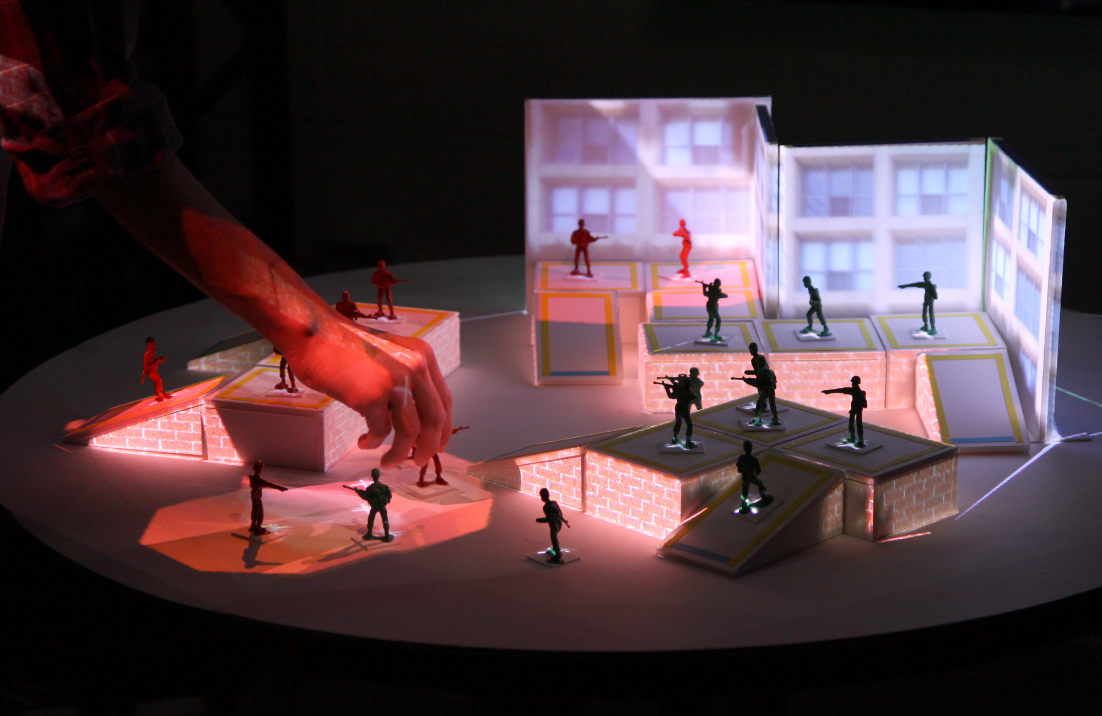
ARmy: A Study of Multi-User Interaction in Spatially Augmented Games
Andrew Dolce, Joshua Nasman, and Barbara Cutler
Department of Computer Science
Rennselaer Polytechnic Institute

Slide 2
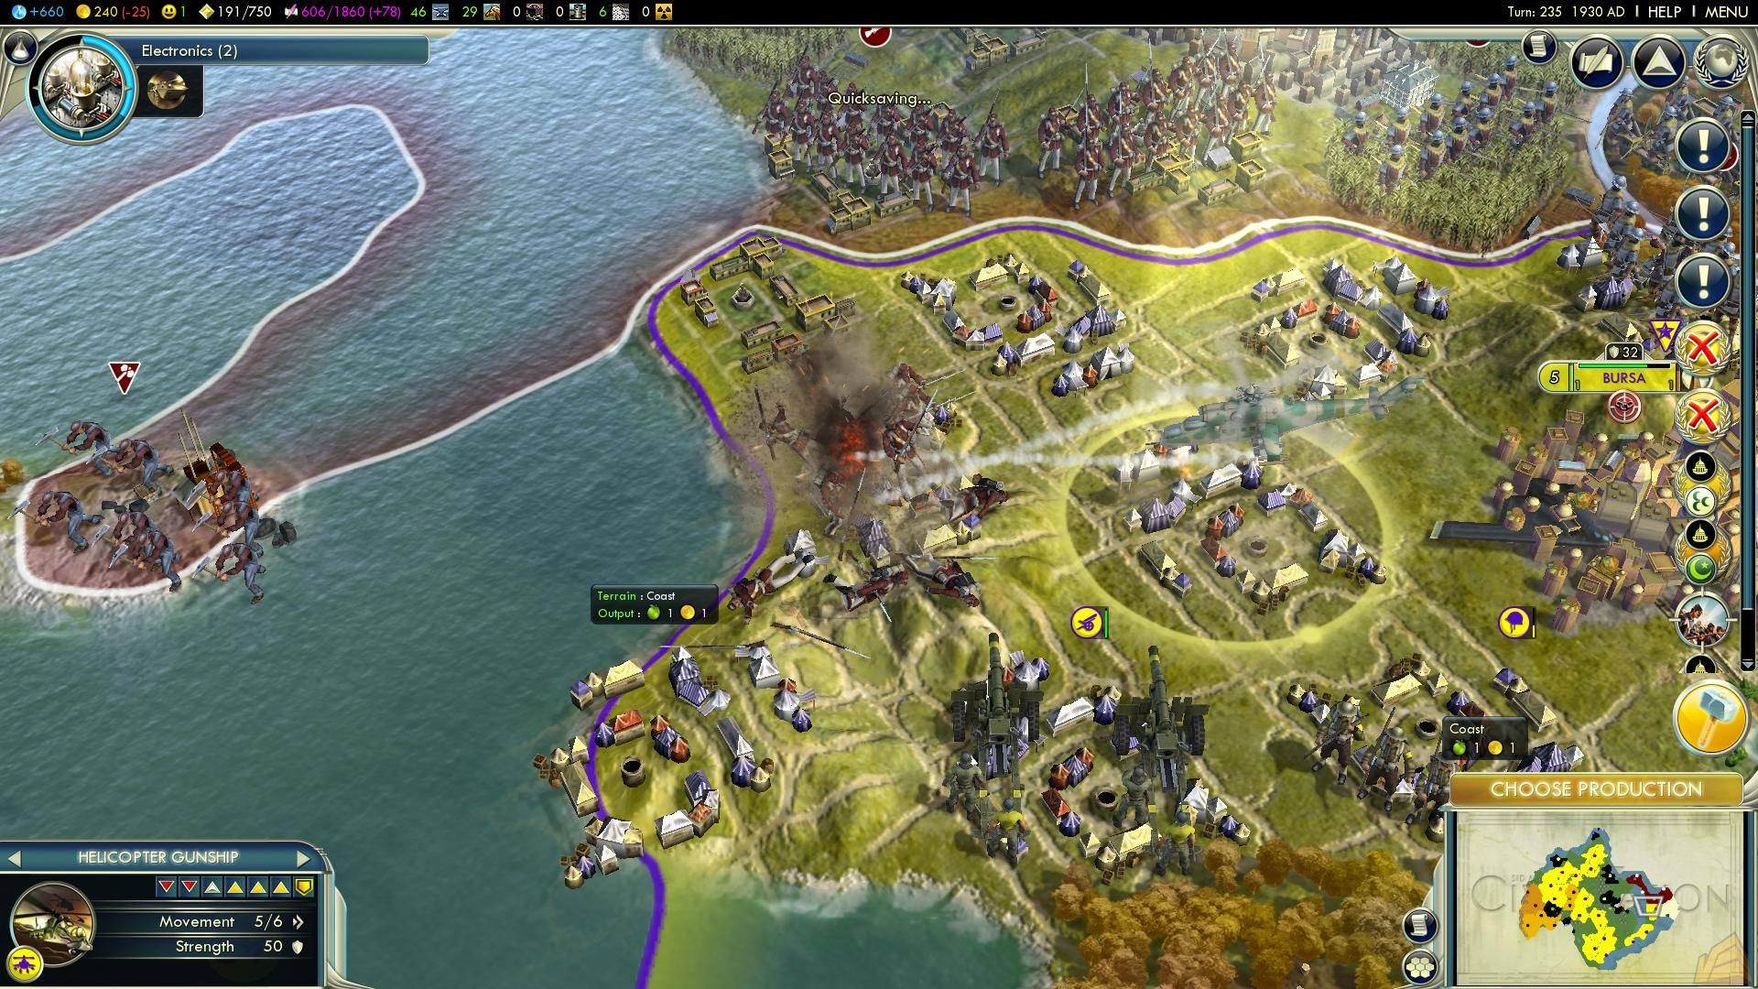
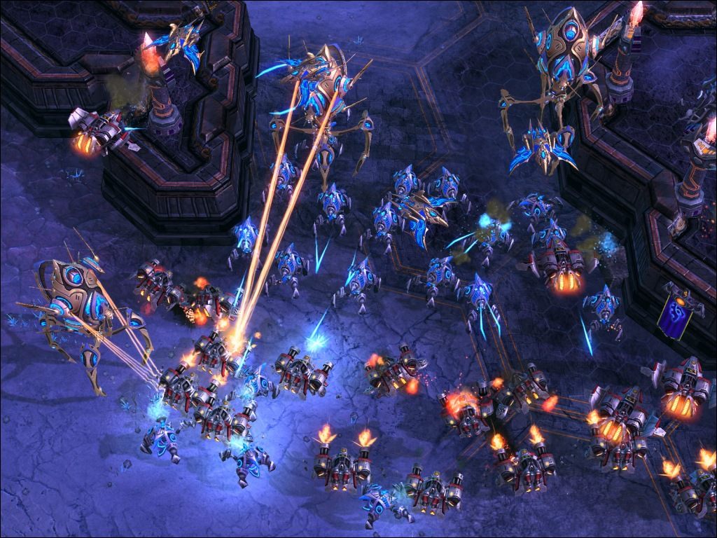
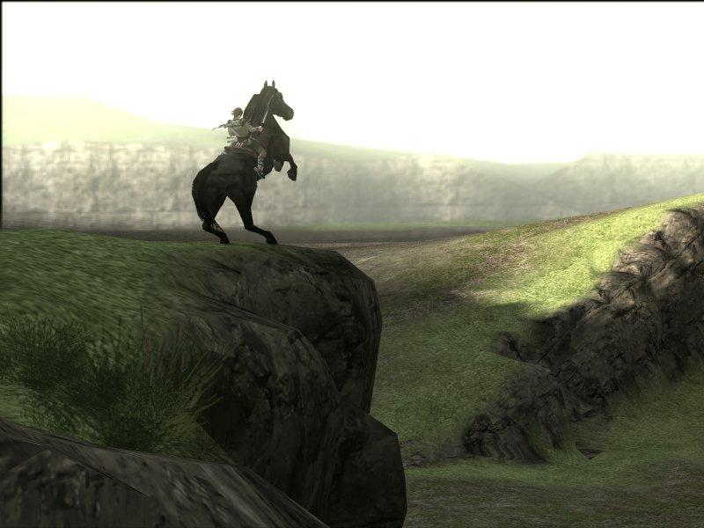
Video Games
Interactive
Simulative
Immersive
Civilization V
Starcraft 2
Shadow of the Colossus

Slide 3
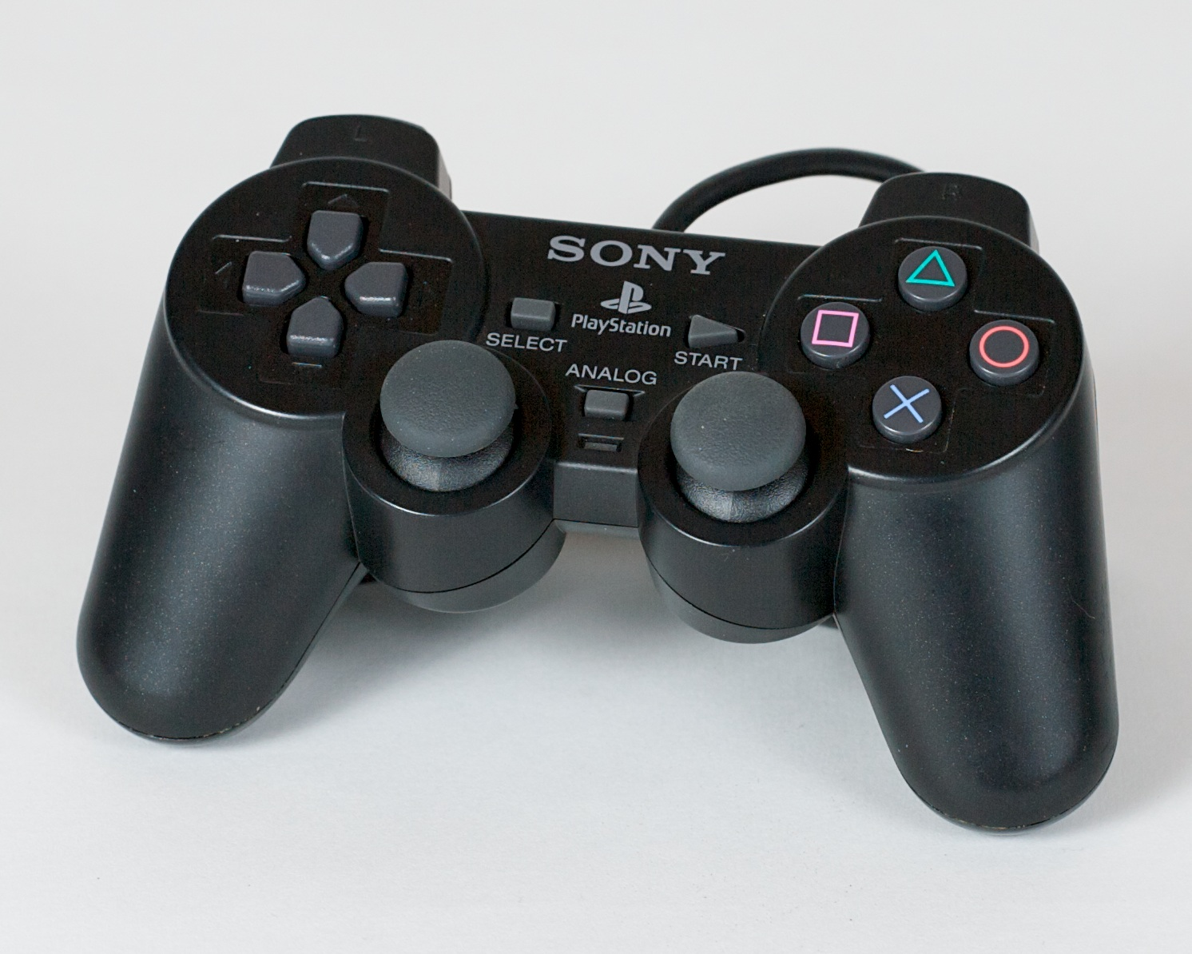
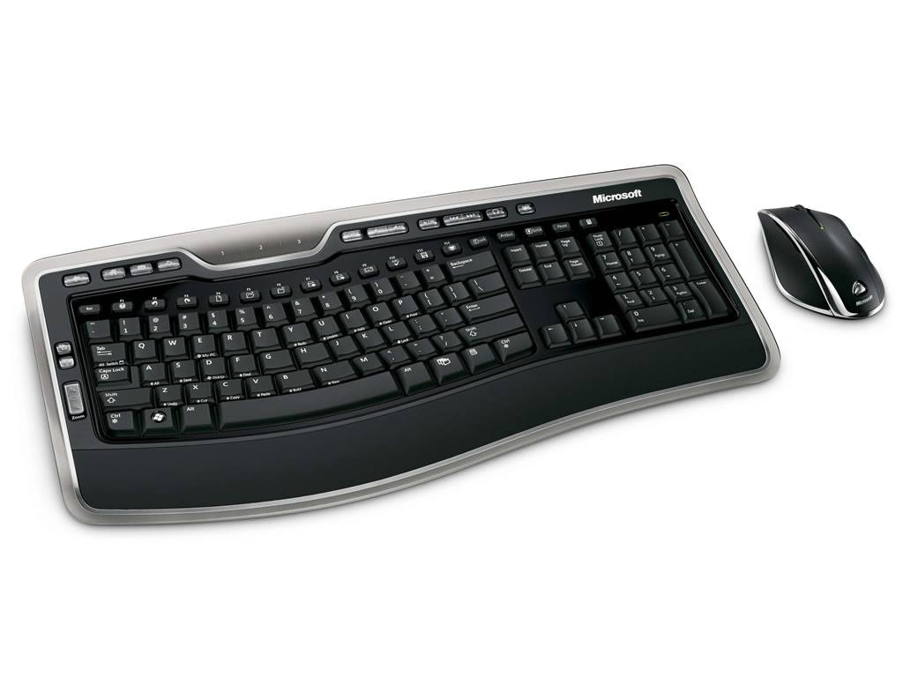

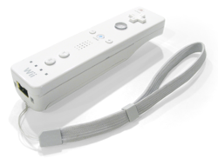
Controls
PlayStation 3 Controller
Mouse and Keyboard
Nintendo Wii Remote
Xbox Kinect

Slide 4

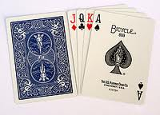
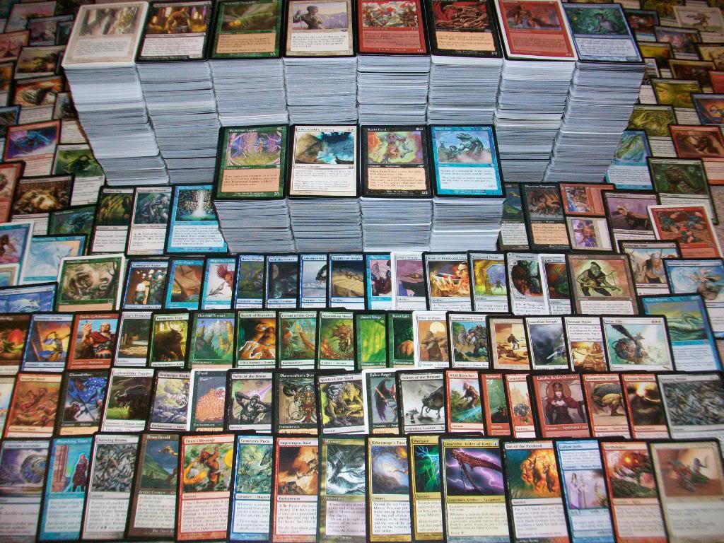
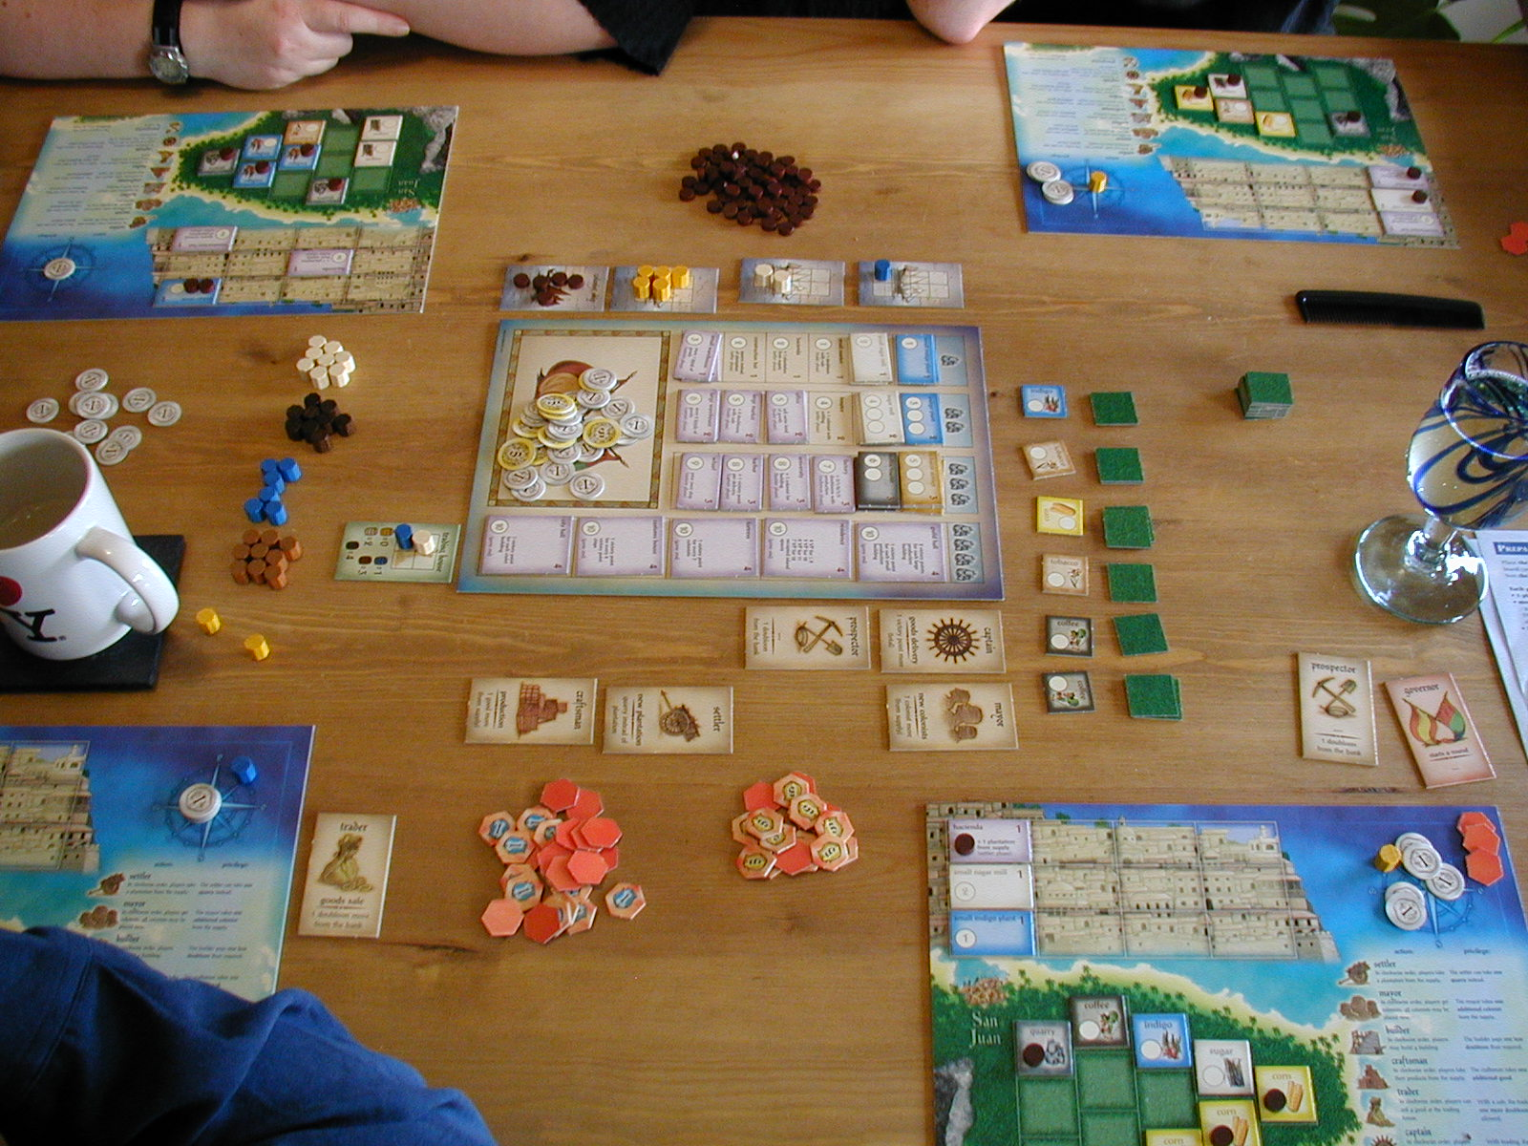
Tabletop Games
Tangible
Intuitive
Face-to-Face
Magic: The Gathering
Puerto Rico

Slide 5
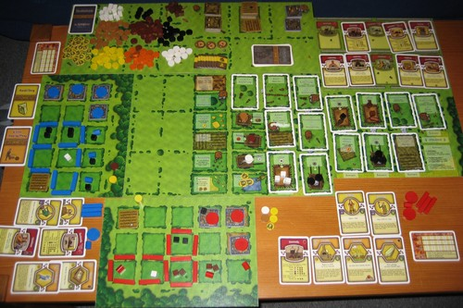
Limited Complexity
Players as moderators
Tedious bookkeeping
Error Prone
Time consuming
Agricola

Slide 6
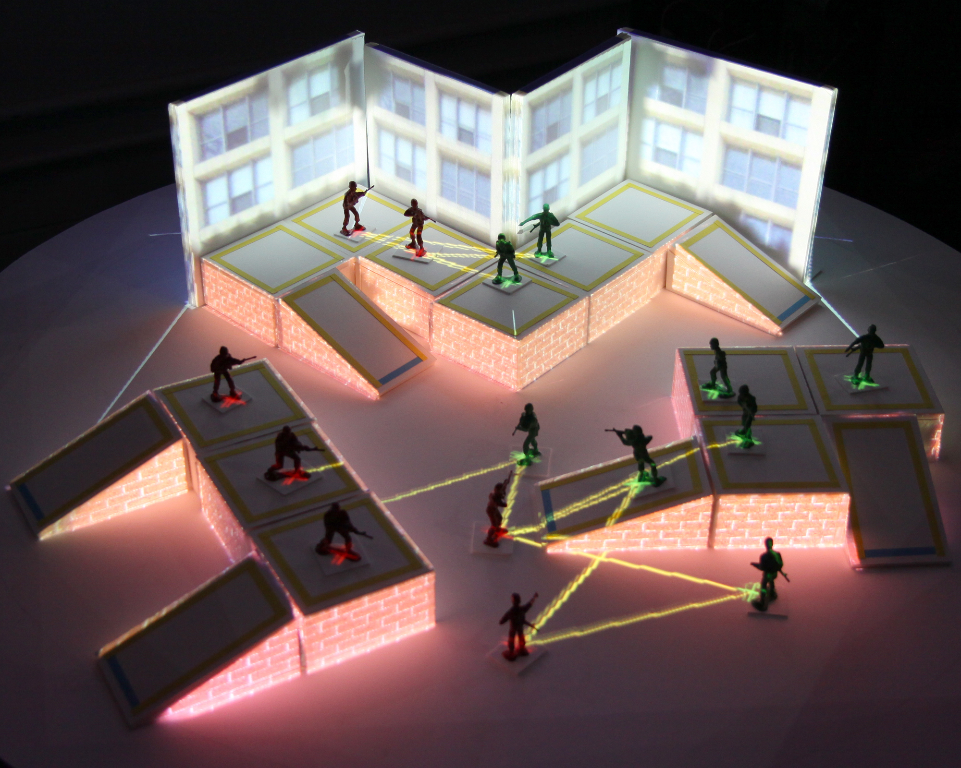
Goals
Develop an AR strategy game that combines the best qualities of virtual video games and tangible tabletop games
Evaluate the effectiveness of the augmentation in improving upon a traditional tabletop game experience

Slide 7
Related Work
O. Bimber and R. Raskar. Spatial Augmented Reality: Merging Real and Virtual Worlds. A K Peters LTD, 2005.
C. Cruz-Neira, D. J. Sandin, and T. A. DeFanti. Surround-Screen Projection-Based Virtual Reality: The Design and Implementation of the CAVE. In Proc. of the 20th Ann. Conf. on Computer Graphics and Interactive Techniques (SIGGRAPH), pages 135–142, 1993.
C. S. Pinhanez. The Everywhere Displays Projector: A Device to Create Ubiquitous Graphical Interfaces. In Proc. of the 3rd Int. Conf. on Ubiquitous Computing, pages 315–331. Springer-Verlag, 2001.
M. Ashdown, M. Flagg, R. Sukthankar, and J. M. Rehg. A Flexible Projector-Camera System for Multi-Planar Displays. In Proc. of the 2004 IEEE Computer Society Conf. on Computer Vision and Pattern Recognition (CVPR), pages 165–172, 2004.
G. W. Fitzmaurice, H. Ishii, and W. A. S. Buxton. Bricks: laying the foundations for graspable user interfaces. In Proc. of the SIGCHI conference on Human factors in computing systems, CHI ’95, pages 442–449. ACM Press/Addison-Wesley Publishing Co., 1995.
J.Leitner,M.Haller,K.Yun,W.Woo,M.Sugimoto,andM.Inami. Incretable, a mixed reality tabletop game experience. In Proc. of the 2008 Int. Conference on Advances in Computer Entertainment Technology, ACE ’08, pages 9–16. ACM, 2008.

Slide 8
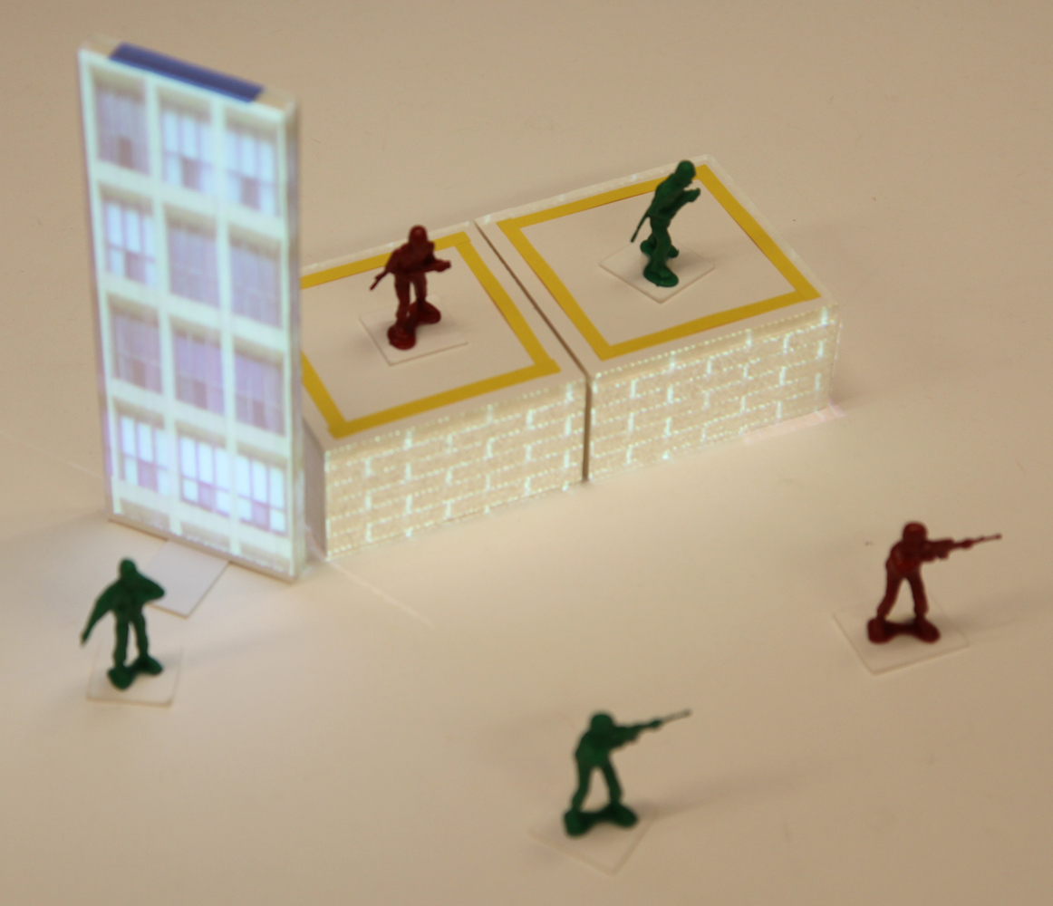
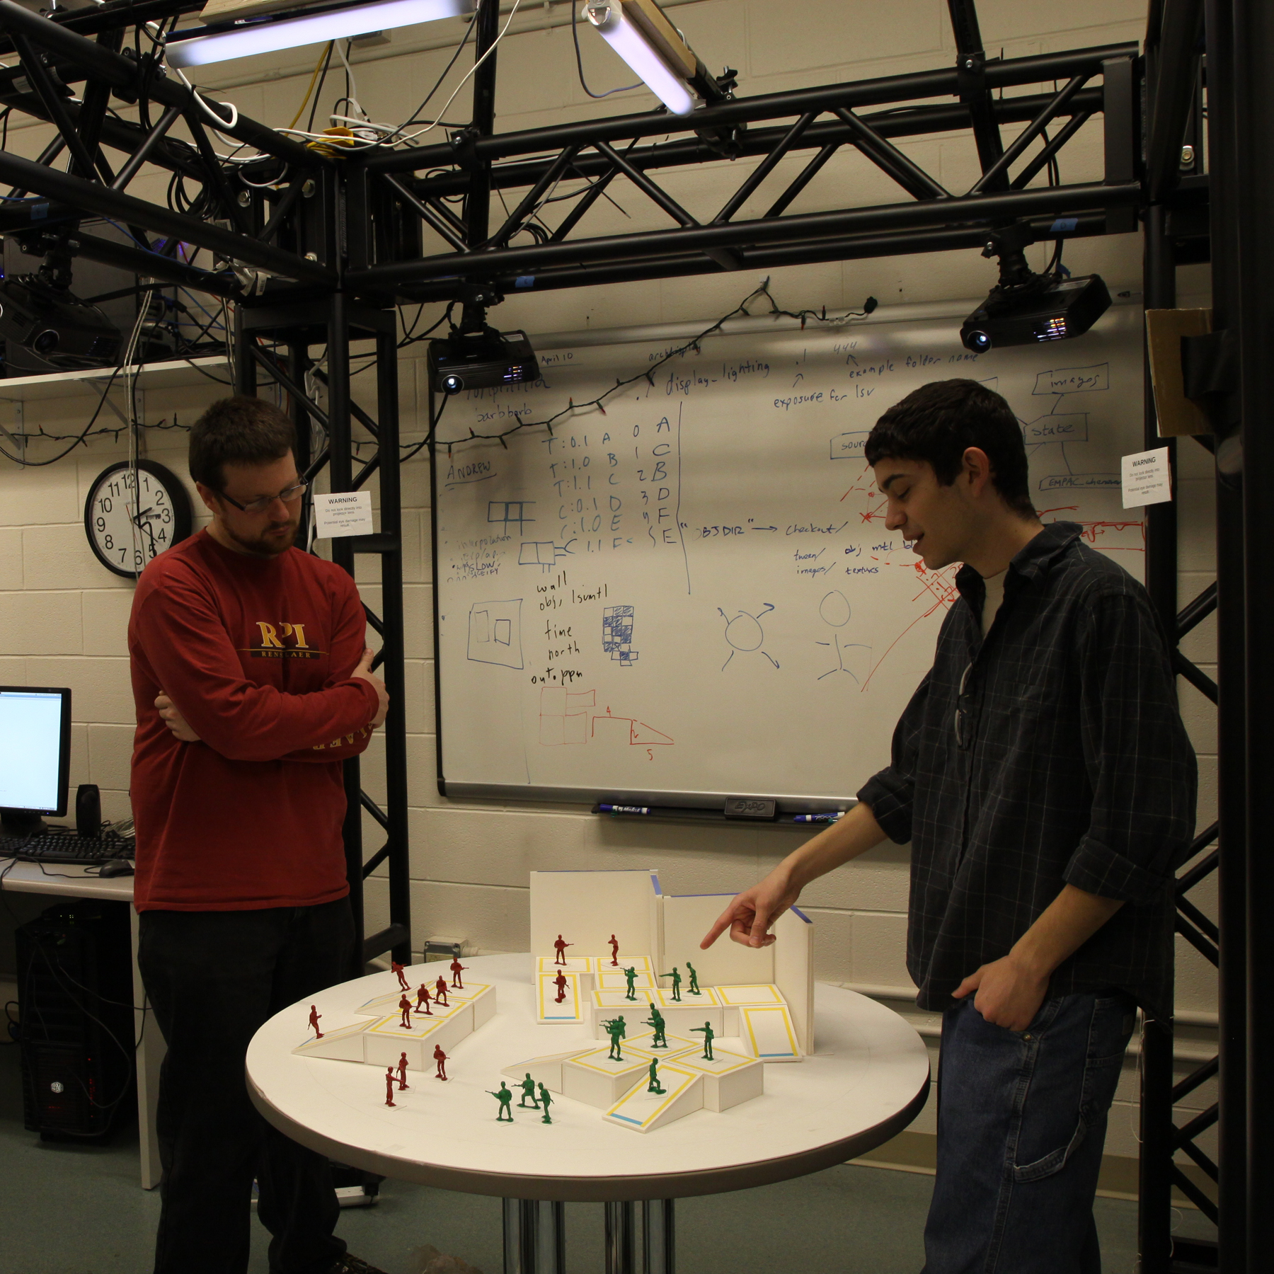
Outline
ARmy
Rules and design
Non-augmented version
Augmentation
User study
Process
Results

Slide 9
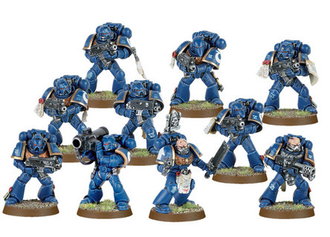
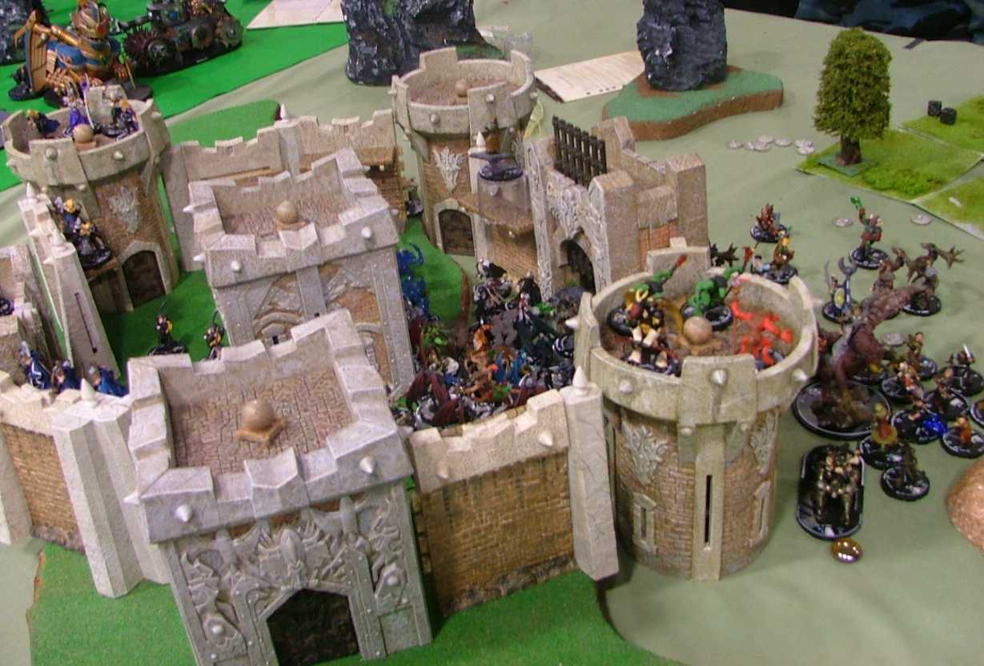
Tabletop Miniature Wargame
Warhammer 40,000
MageKnight

Slide 10
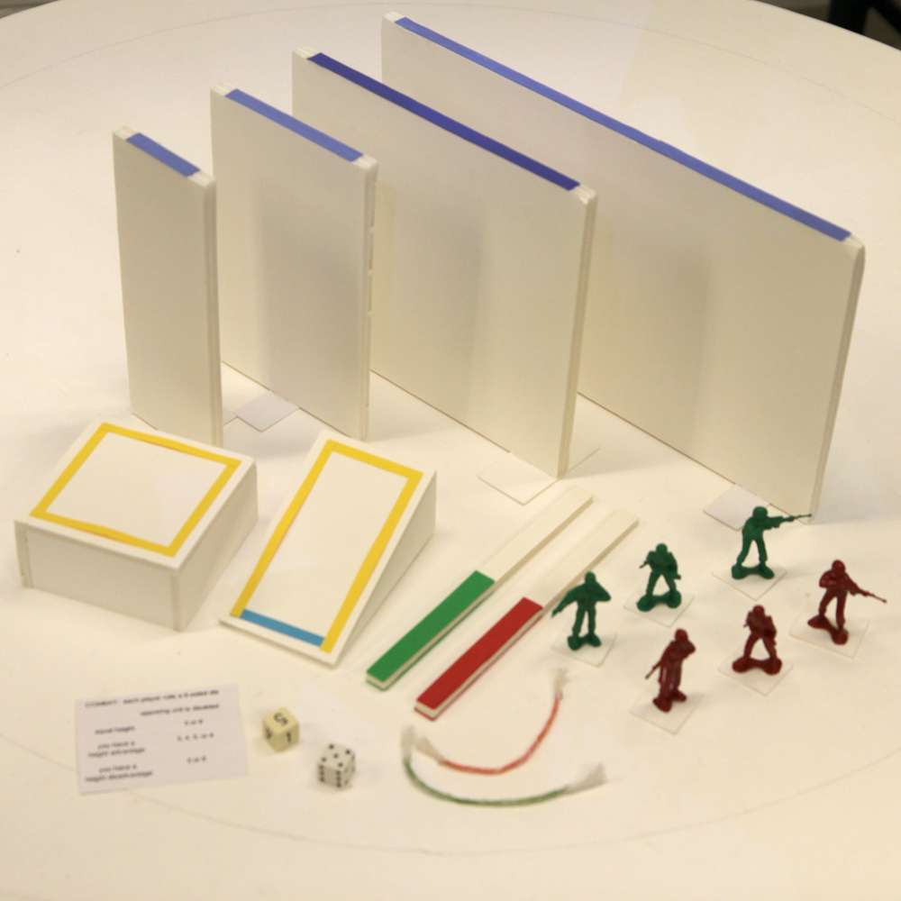
ARmy Game Pieces
Two opposing armies of 2” plastic soldier “units”
Battlefield configured from foam-core pieces
8” walls
4” x 4” x 2” platforms
3” x 5” x 2” ramps

Slide 11
Game Flow
Combat Cleanup
Setup
Red or Green
Move
Game Over
Combat

Slide 12
Non-Augmented Play
Distances measured using flexible rulers
Combat outcomes determined by rolling dice

Slide 13
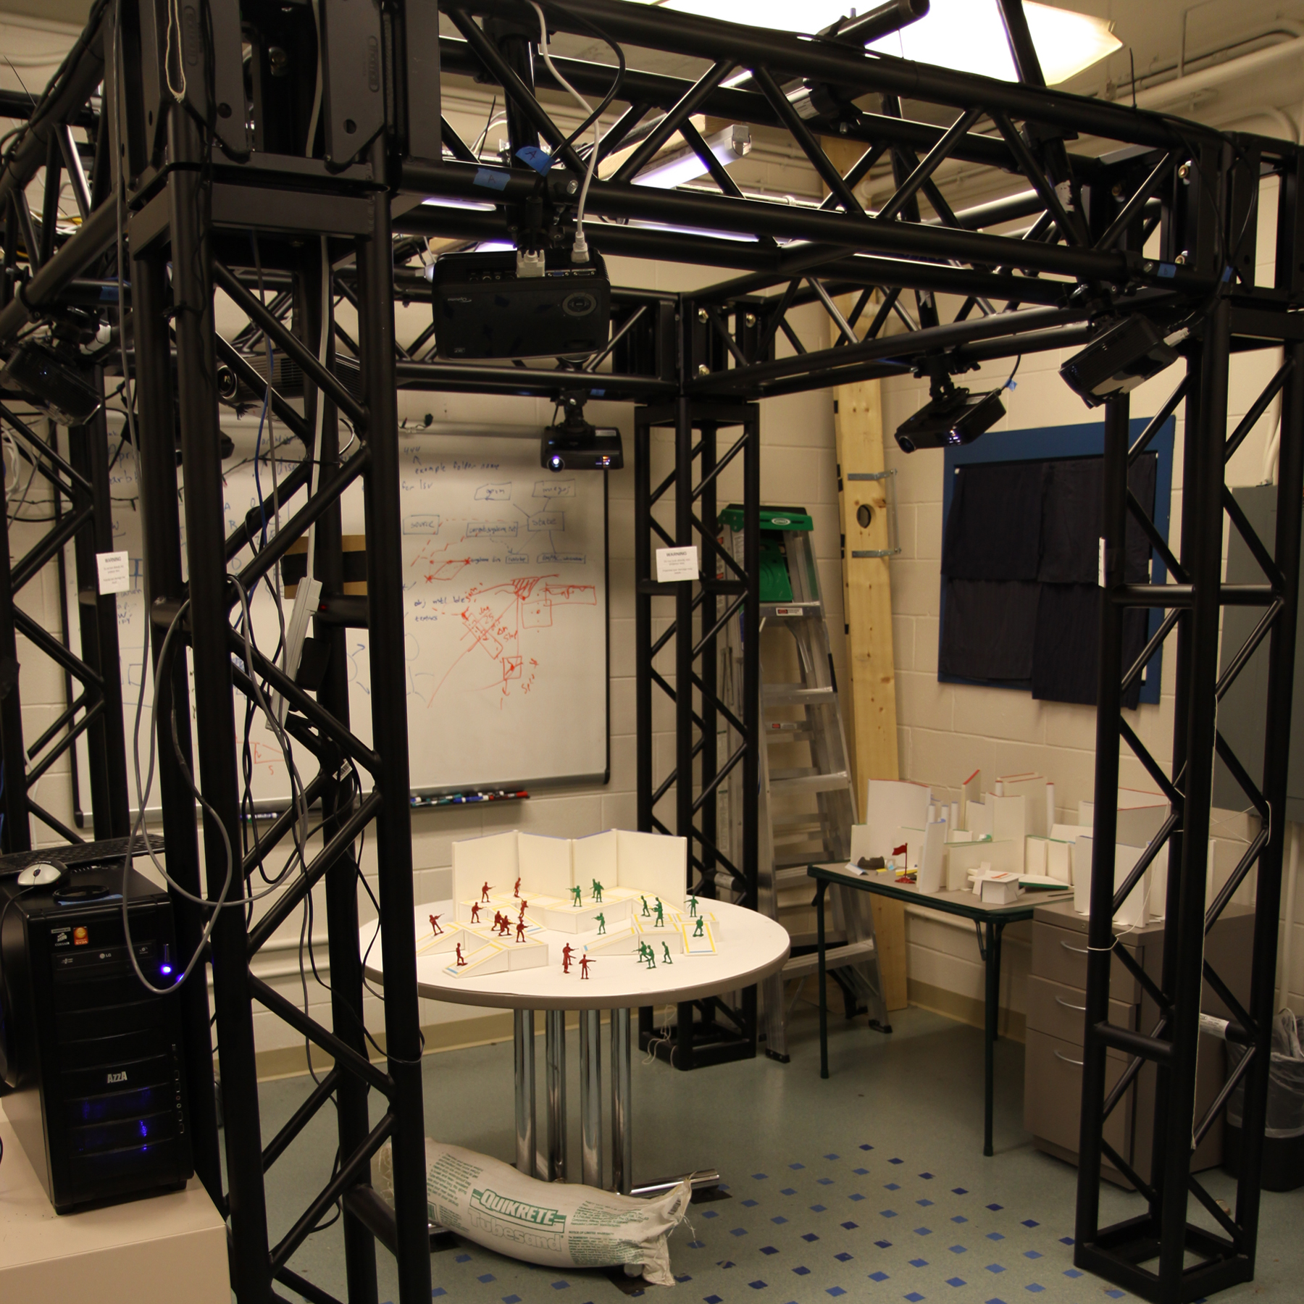
SAR System
Camera detects objects in scene
Projectors display images directly onto the dynamic surface
camera
projectors

Slide 14
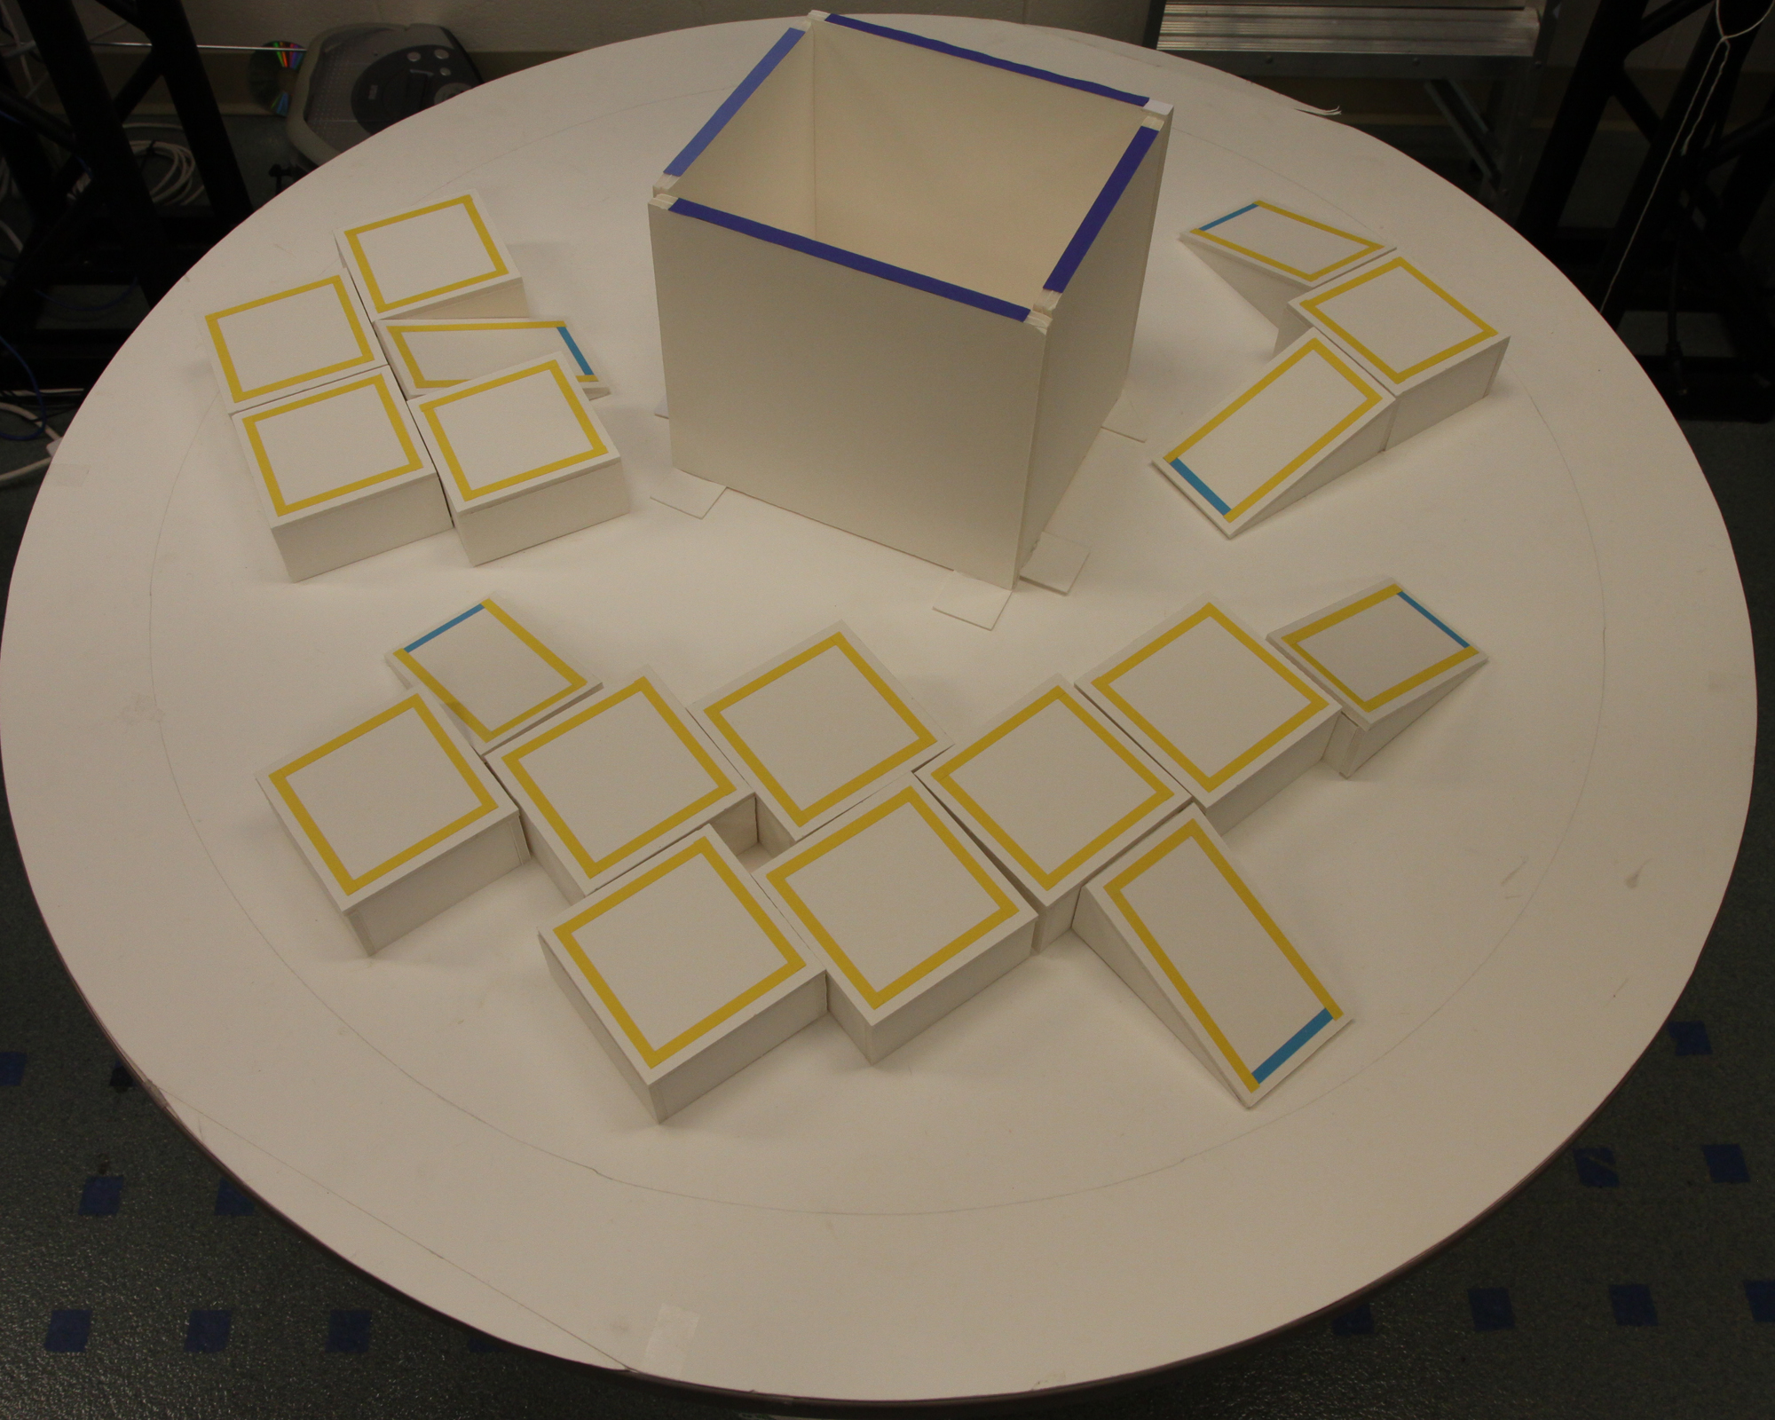
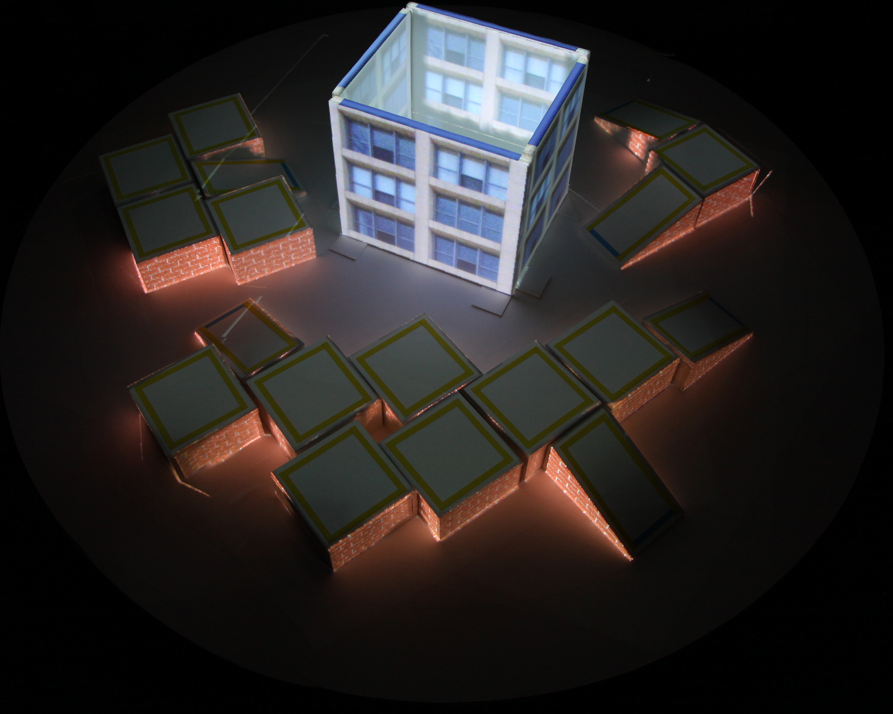
ARmy Augmentation
Track and validate game state
Convey information
Apply imagery

Slide 15
Augmented Play

Slide 16
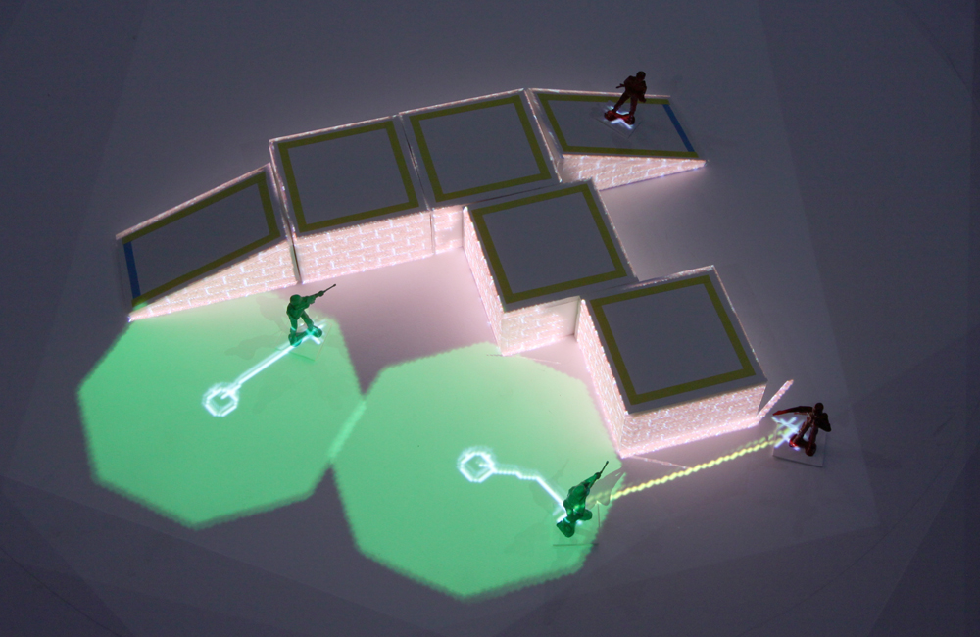
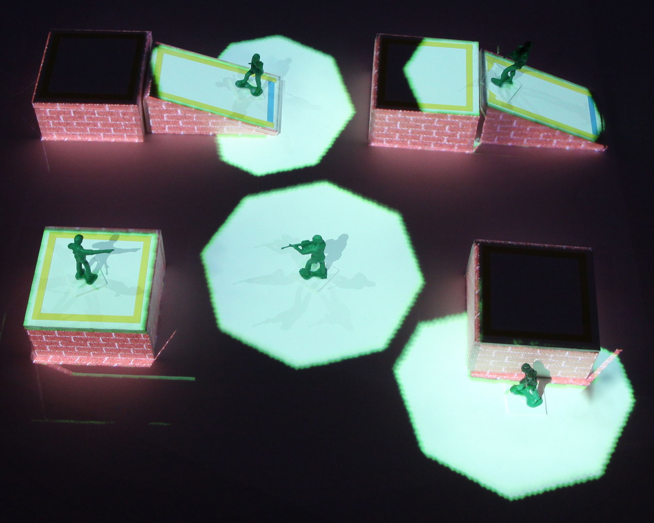
Movement Phase

Slide 17
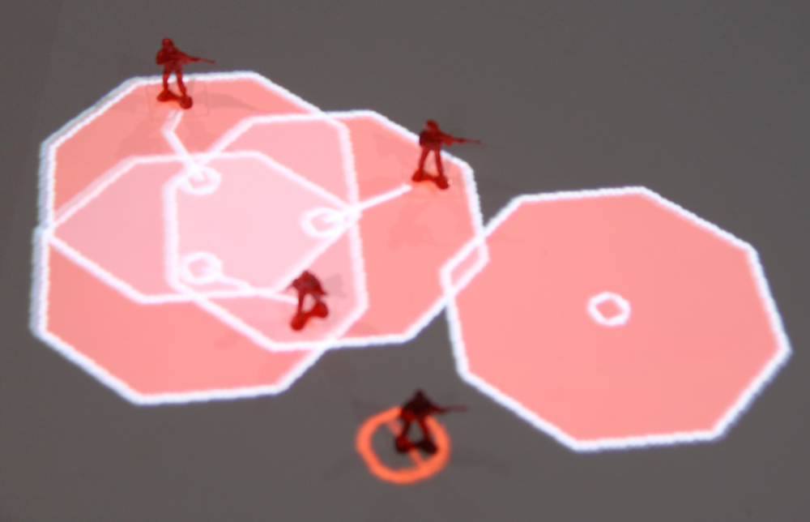
Illegal Moves

Slide 18
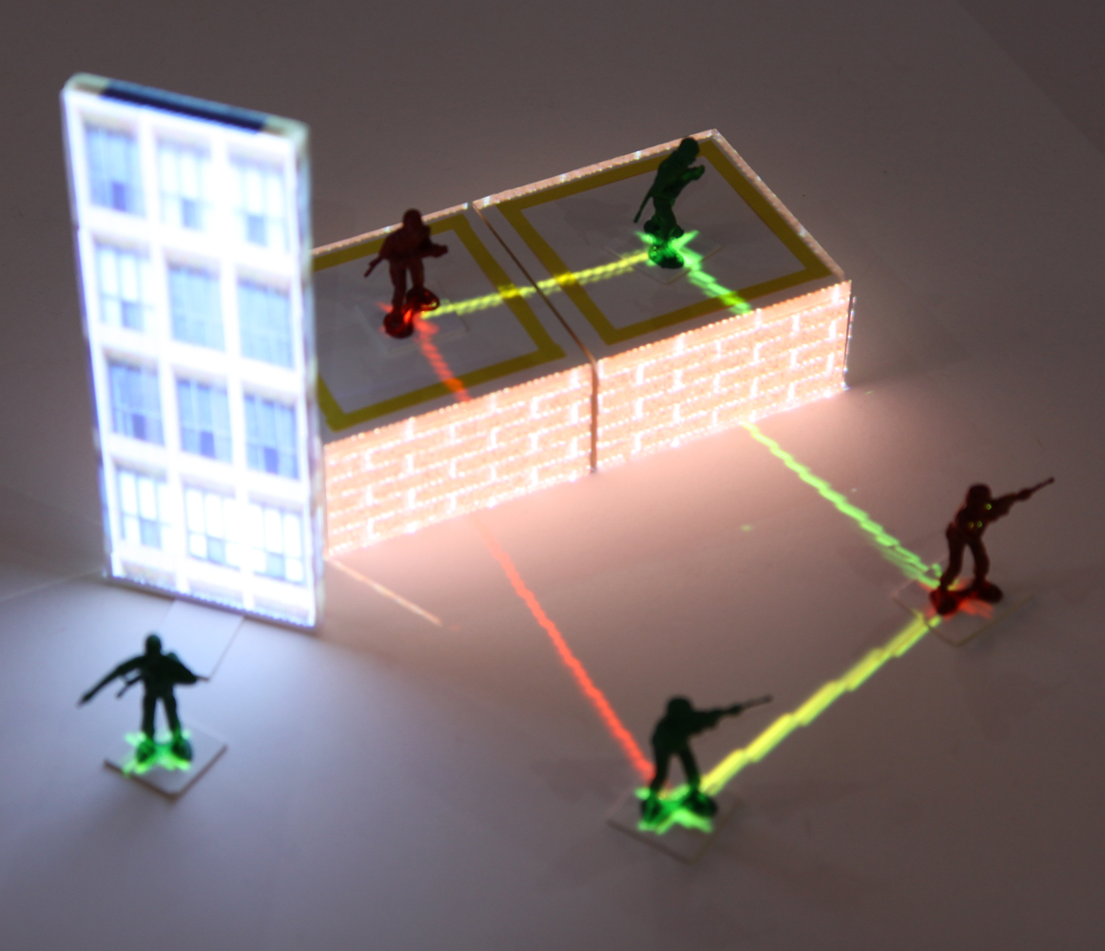
Combat Phase

Slide 19
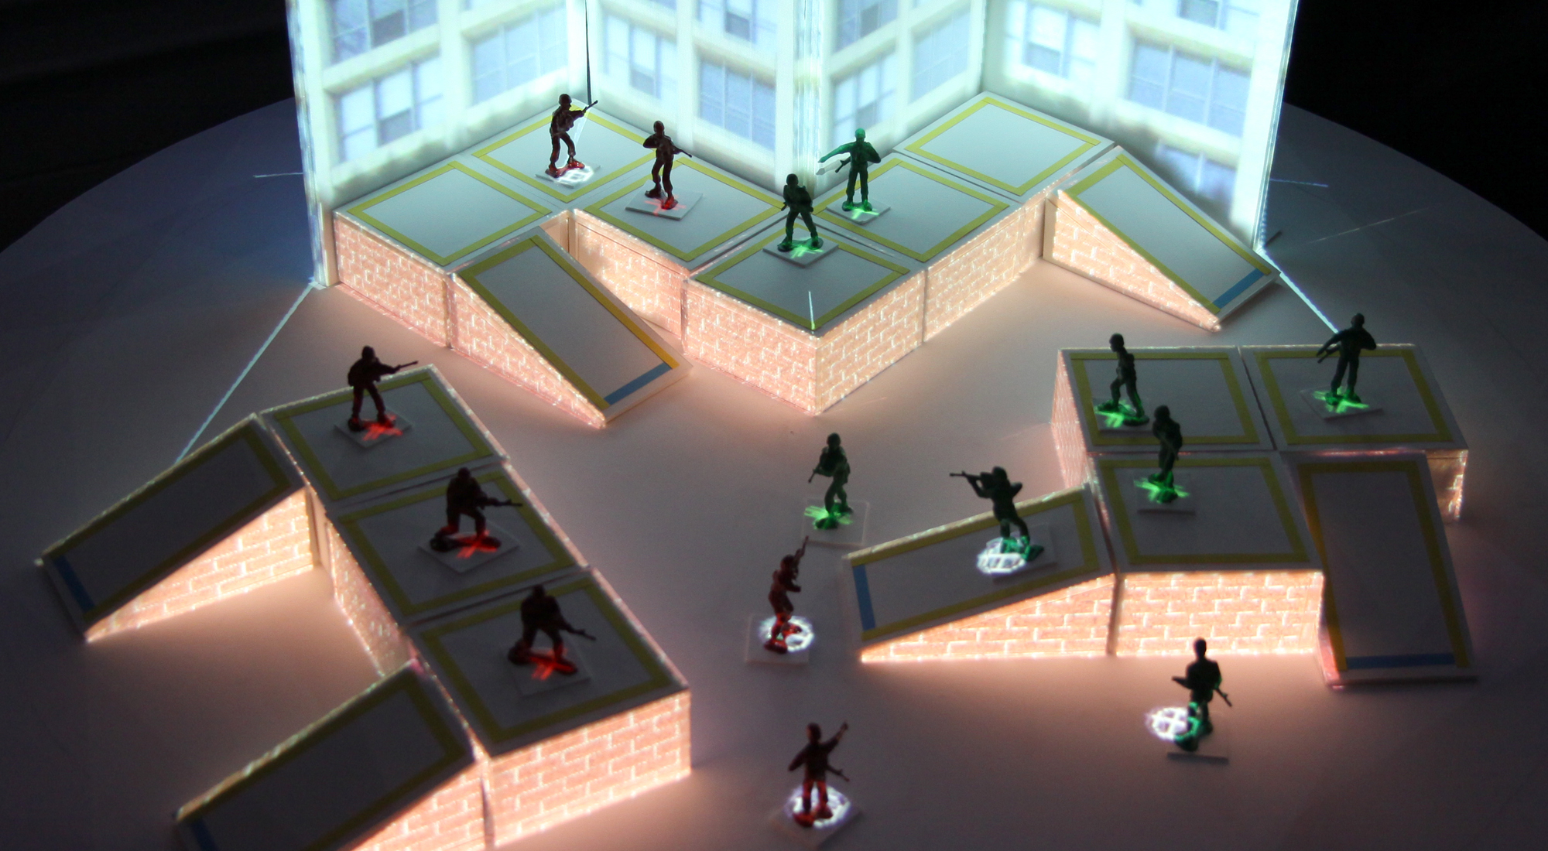
Combat Cleanup

Slide 20
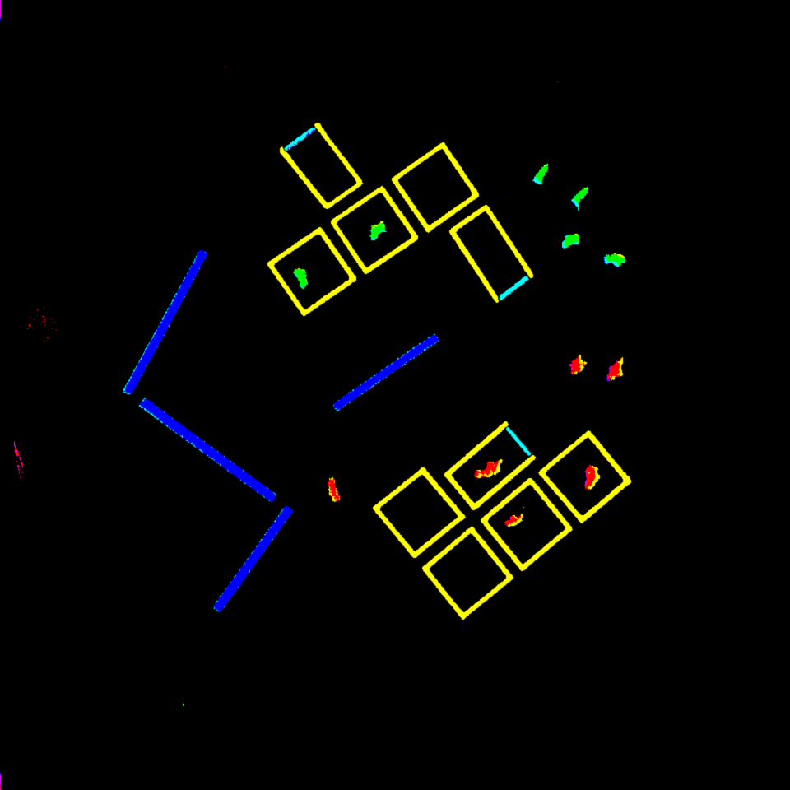
Detection Details
Discrete snapshots
Detected pieces as colored components
Why color?

Slide 21


Enumerating Legal Moves
Construct connected graph from 2D heightfield
Enumerate legal moves via BFS

Slide 22
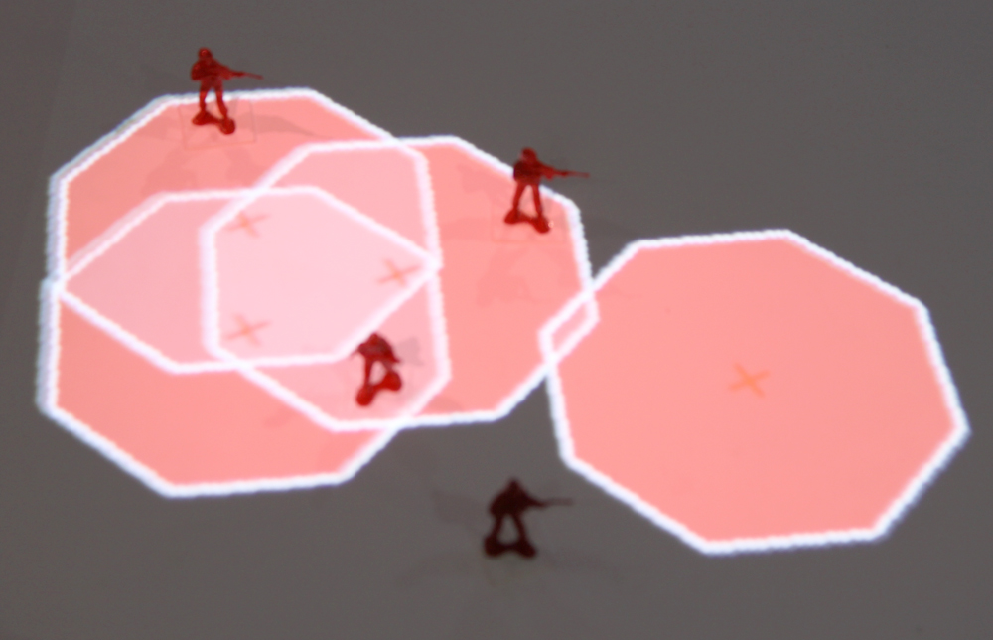
Frame-to-frame Matching
Current tracking does not uniquely identify units
Deduce likely correspondences using Kuhn-Munkres algorithm

Slide 23
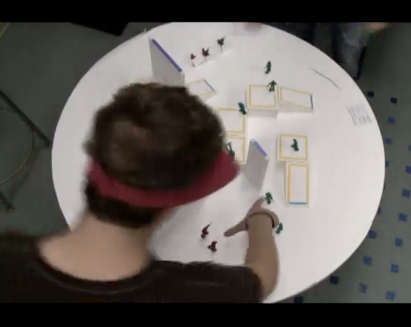
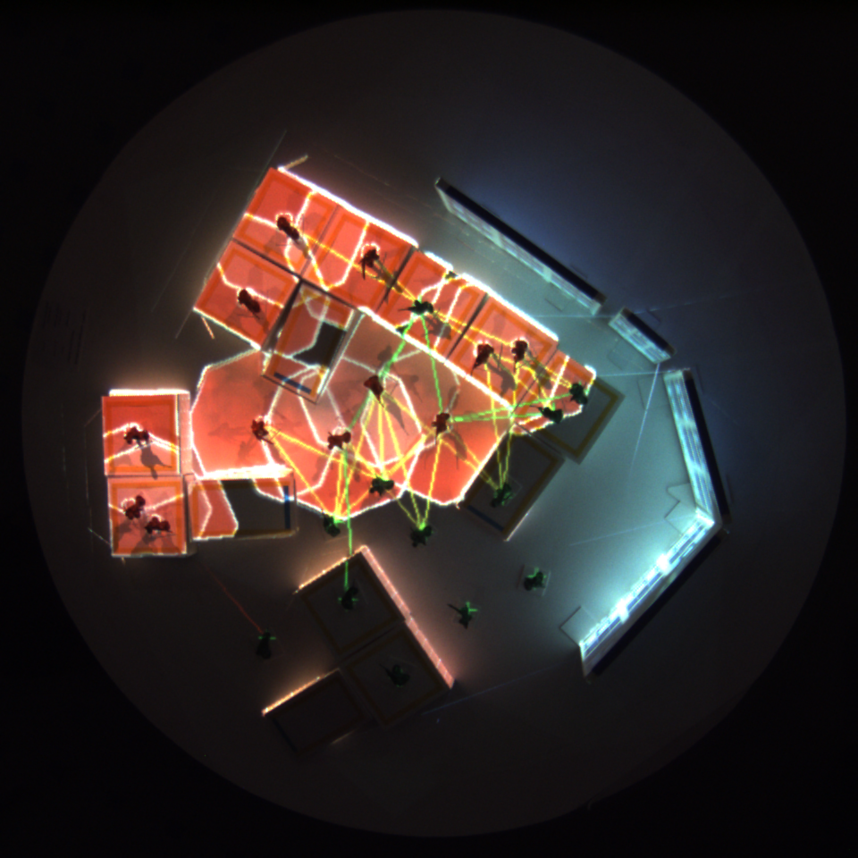
User Study Process
Explanation of rules (~10 mins)
“Practice” round (~15 mins)
Practice with both versions
2 full games in random order:
Augmented version
(max 20 mins)
Non-augmented version
(max 20 mins)
Recorded video and still images
Written questionaire

Slide 24
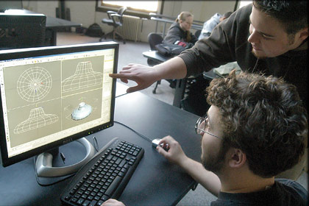
Participant Backgrounds
18 total ( 6 females, 12 males )
Students of Games and Simulations Arts and Sciences Major (GSAS)
At least 3 years computer gaming experience
All had some experience playing tabletop games
Half had prior experience with games similar to Warhammer 40k

Slide 25
User Ratings
Average Rating | Non-augmented All (18) 2nd only (10) |  | Augmented All (18) 2nd only (10) |  | Delta (all)
Accuracy of distance | 3.7 | 4.0 | 4.5 | 4.1 | 0.8
Accuracy of sight lines | 3.8 | 4.0 | 4.8 | 4.6 | 0.9
Accuracy of rules | 3.8 | 3.9 | 4.6 | 4.4 | 0.8
Subjectivity | 4.1 | 3.9 | 4.6 | 4.6 | 0.6
Interest | 3.5 | 3.9 | 4.6 | 4.6 | 1.1

Slide 26
Timing Data
Averages | Non-augmented All (9) 2nd only (3) |  | Augmented All (9) 2nd only (5)
Terrain setup | 1:16 | 1:13 | 2:46 | 2:07
Army Placement | 2:52 | 2:38 | 3:03 | 3:11
Movement phase | 0:42 | 0:36 | 0:52 | 0:47
Combat phase | 1:33 | 2:13 | 0:22 | 0:18
Single Battle | 0:16 | 0:21 | 0:04 | 0:03
# rounds per game | 2.3 | 2.0 | 3.9 | 4.1
# battles per game | 26.1 | 24.5 | 36.6 | 41.0

Slide 27
Non-AR Pros
“a little more hands on”
“Felt responsible for the outcome of the dice”
“Slight bending of rules”
Non-AR Cons
“Much slower combat”
“occasional confusion”
“While we made decisions, they were not necessarily the correct ones in terms of the rules.”
AR Pros
“easy to see how far you can move”
“no disagreement between players since there was an ultimate referee”
“visually stimulating”
AR Cons
“waiting for recalculation”
“Blind spots forced us to simplify our terrain design a bit.”
“Watched action happen rather than rolling the dice. Takes away your feeling of involvement.”

Slide 28
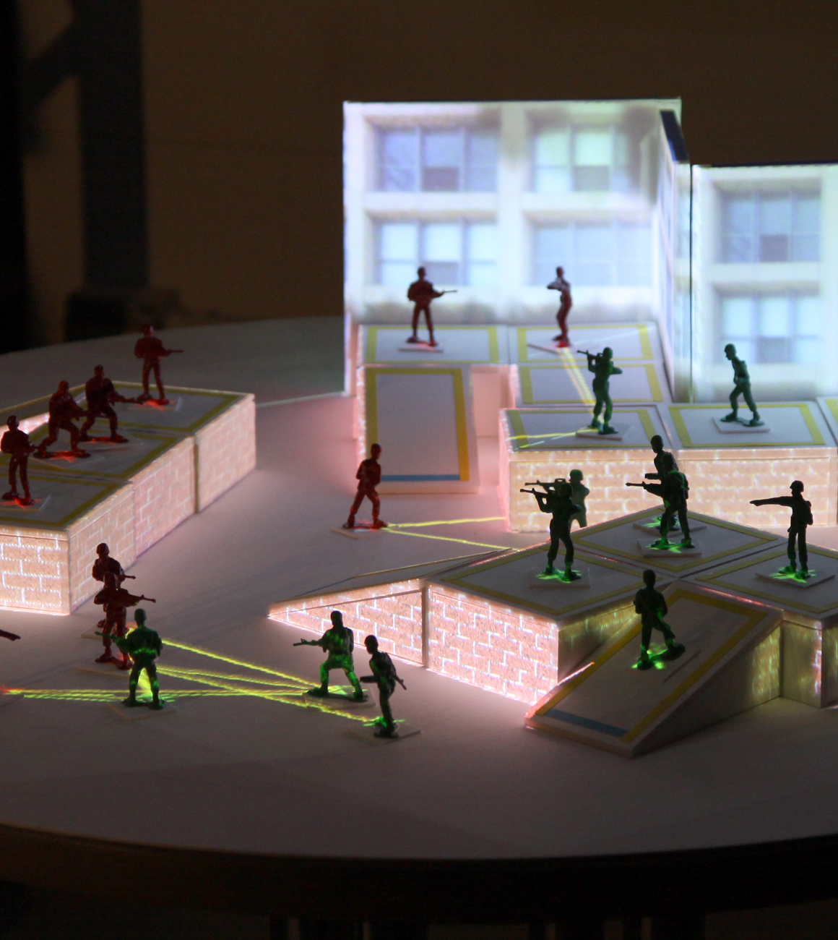
Conclusions
Feedback for SAR was generally positive
All but 2 people preferred augmented
System proved fairly robust
Take care not to remove player involvement
Transparent outcomes
Decisions
Need to be tolerant of slight player error

Slide 29
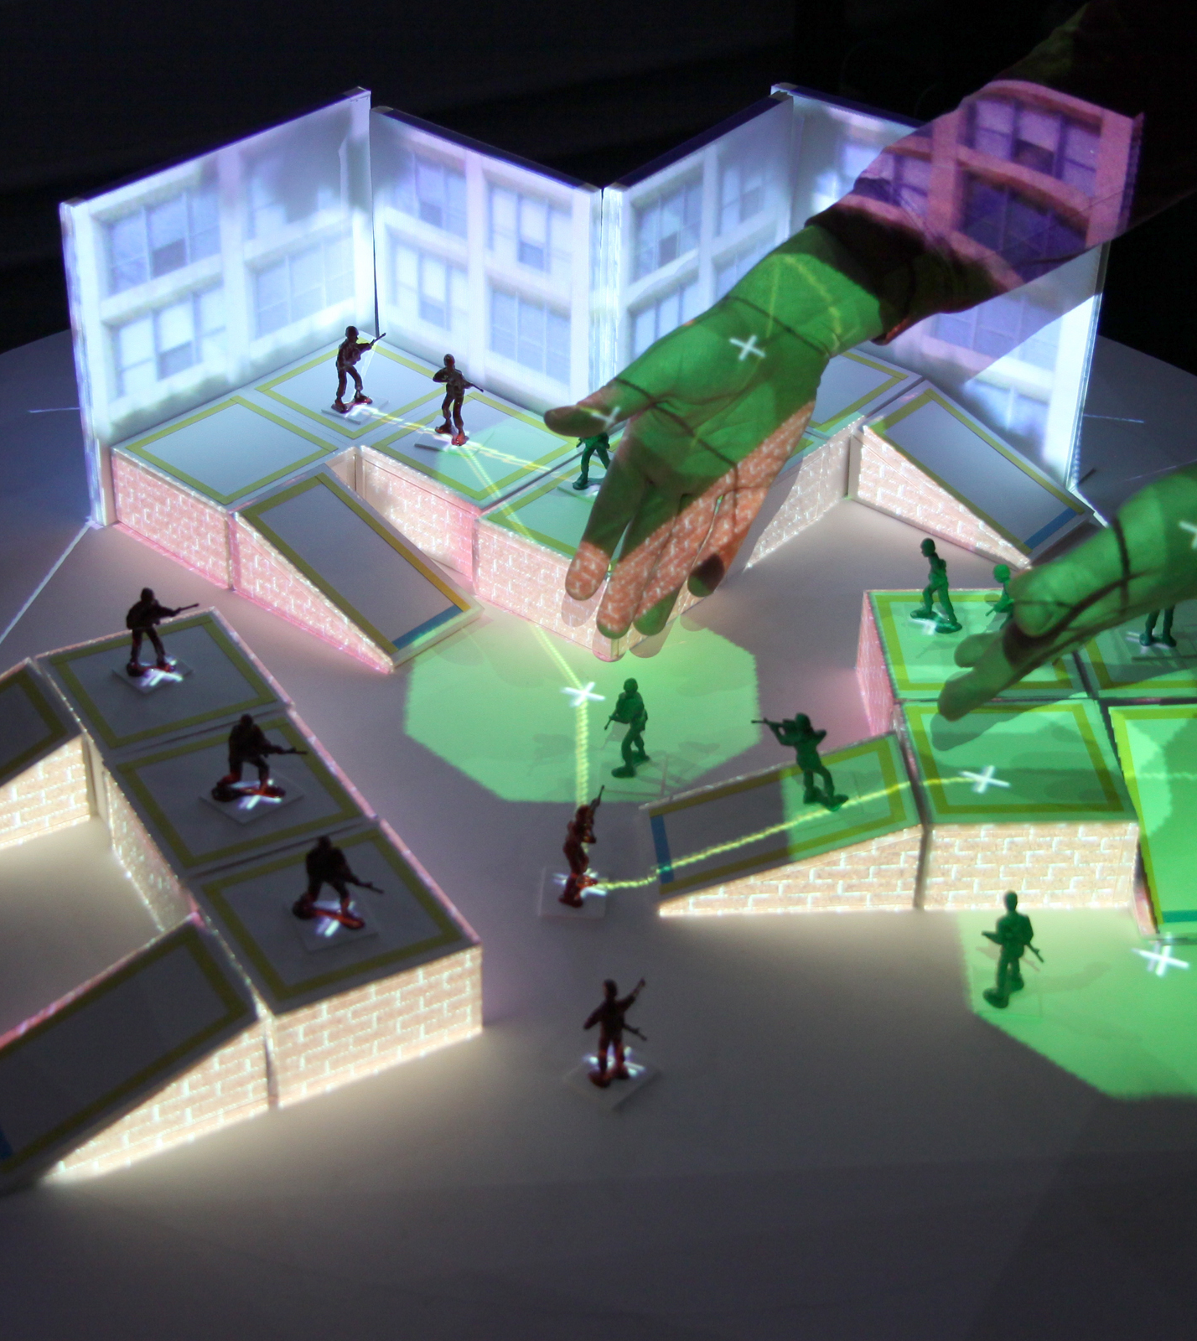
Future Work
Simultaneous acquisition and display
Application to arbitrary games:
Improved object recognition
Finer-grain controls
Audio

